Slide 1
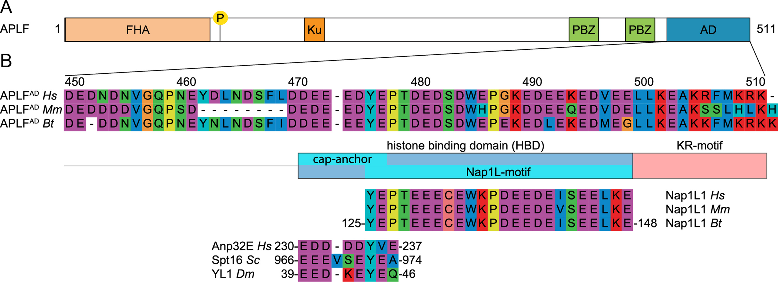

Figure 1. APLF contains an extended HBD in its acidic domain. (A) Schematic representation of the APLF domain ...
Notes:
Figure 1. APLF contains an extended HBD in its acidic domain. (A) Schematic representation of the APLF domain architecture. FHA = Forkhead associated domain, P = phosphorylation site Ser<sup>116</sup>, Ku = Ku-binding motif, PBZ = Poly(ADP)ribose Binding Zinc finger, AD = acidic domain. (B) Sequence alignment of APLF<sup>AD</sup>, motif analysis and alignment with histone chaperones. APLF<sup>AD</sup> shows conservation among species and with two motifs from histone chaperones: the NAP1L-motif present in Nap1-like proteins and the H2A-H2B binding cap-anchor motif of histone chaperones Anp32E, Spt16 and YL1. The amino acids are displayed by Seaview with color coding according to amino acid properties. Abbreviations: Hs = Homo sapiens; Mm = Mus musculus; Bt = Bos taurus; Sc = Saccharomyces cerevisiae; Dm = Drosophila melanogaster.
Unless provided in the caption above, the following copyright applies to the content of this slide: © The Author(s) 2018. Published by Oxford University Press on behalf of Nucleic Acids Research.This is an Open Access article distributed under the terms of the Creative Commons Attribution Non-Commercial License (http://creativecommons.org/licenses/by-nc/4.0/), which permits non-commercial re-use, distribution, and reproduction in any medium, provided the original work is properly cited. For commercial re-use, please contact journals.permissions@oup.com

